Slide 1

Airport Restaurant Violation Report
Shaun Pritchard - Module 3 - QMB4000
Full Code to Google Colab Jupyter notebook file: https://colab.research.google.com/drive/1D8QHgytwpImNNJi5XKqN3z_WuNd4m--B?usp=sharing

Slide 2
Key Points
We will be looking at Airport restaurant dataset to find correlations and trends based on the code violations for all district restaurants inside the given airports. The categories of trends we will be looking for are as follows:
Total Number Of Violations
Most Popular Violation
Cuisine With Largest Number Of Violations
Total Number Of Restaurants In Each Airport
Restaurants With Highest Grade
Dates That Highest Violations Occurred
Restaurant With Most Recurring Violations.

Slide 3
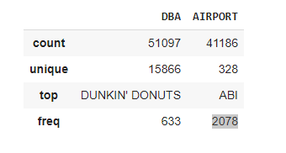

Q1. Total Number of Violations
Data Results
Code:
Based on the description of the data there is a count of 2078 total violations.
This data also shows us the top violation are accrued from the company DBA

Slide 4
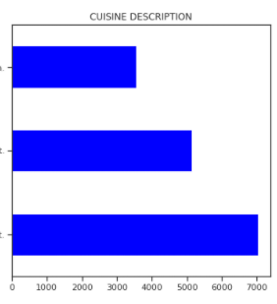
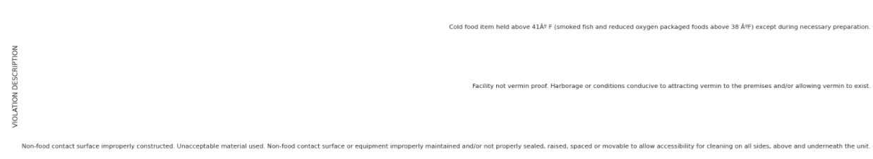
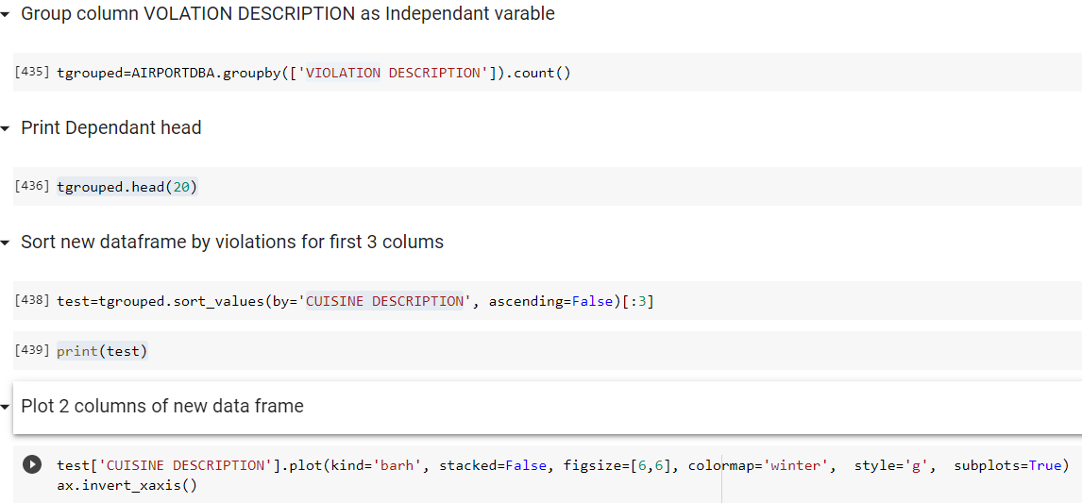
Q2 Most Popular Violation
Data Results
Code Screenshot
Top 3 worst violations:
Non-food contact surfaces being used
Facility not vermin proof
Cold food items stored above freezing temps 41 deg.
Description:
These are the worst violations per frequency in relation to airport businesses who failed inspections.

Slide 5
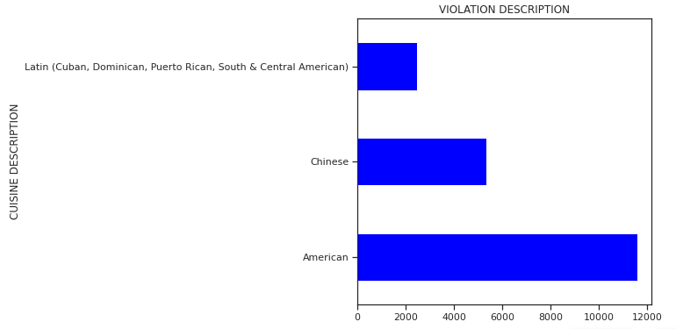
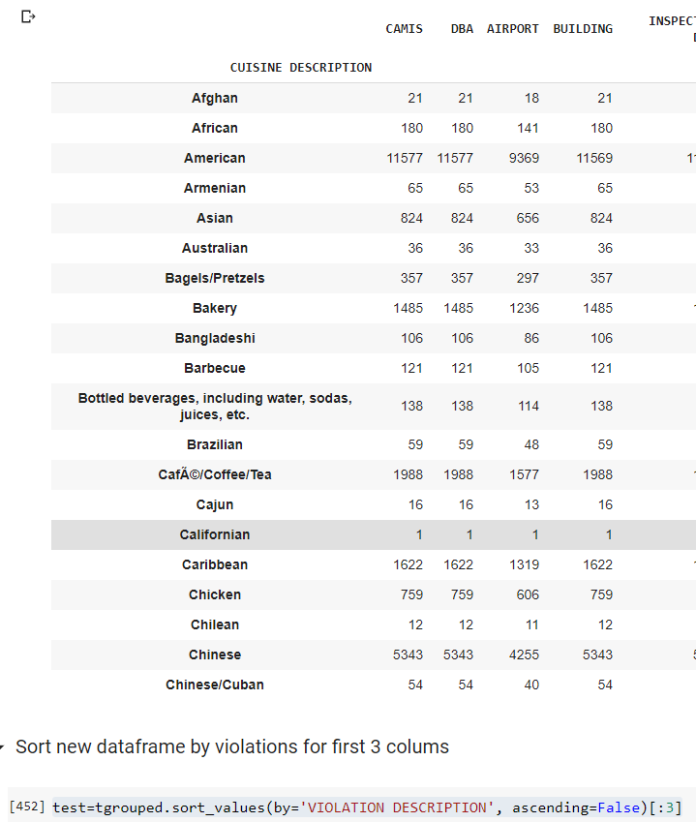
Q3 Cuisine With Largest Number of Violations
Data Results
Code Screenshot
Description:
These are the cuisines which received most violations.

Slide 6
Q2 Total Number of restaurants at Each airport
Data Results
Code Screenshot
Description: This data reflects the number of restaurants at each airport 51097 restaurants

Slide 7
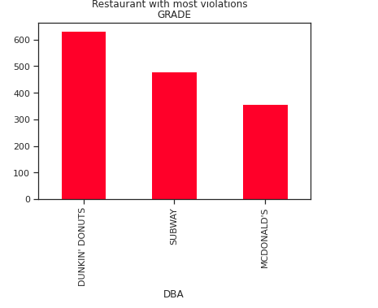
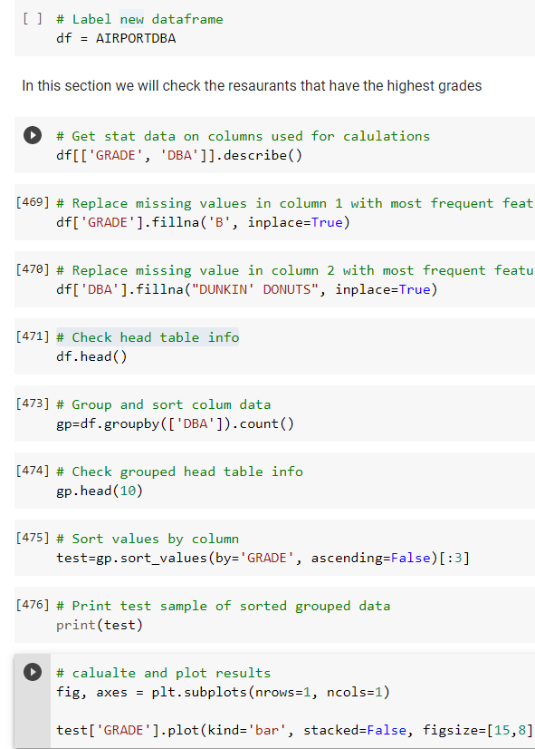
Q5: Restaurants with Highest Grade
Data Results
Code Screenshot
Description: This shows the top restaurants with the highest grade and who passed more inspections.

Slide 8
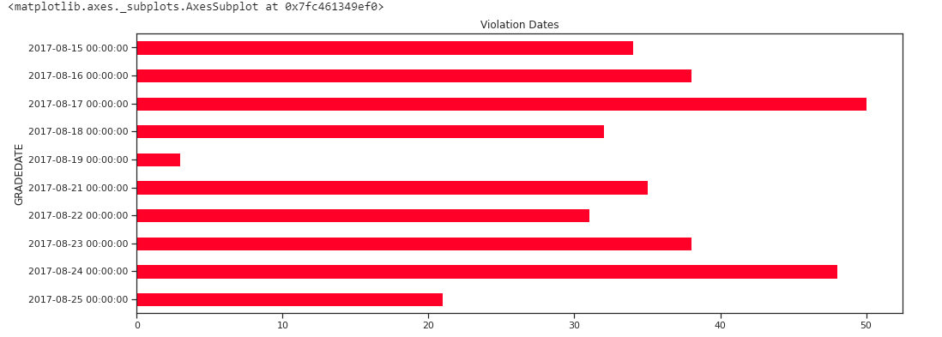
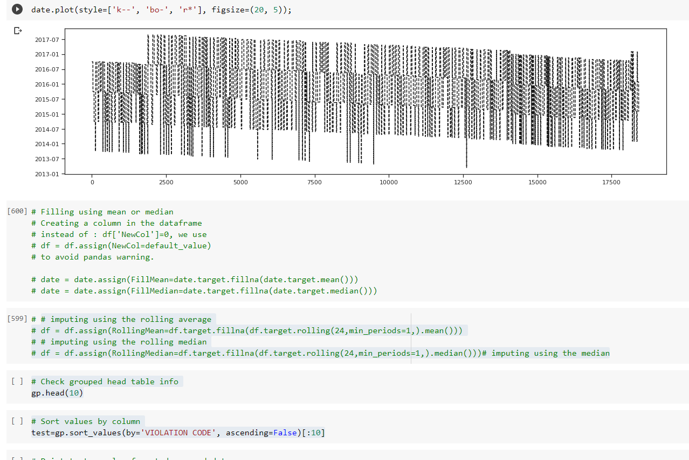
Q2 Dates Highest Rate of violations occurred
Data Results
Code Screenshot
Description These are the most frequent dates when violations occurred

Slide 9
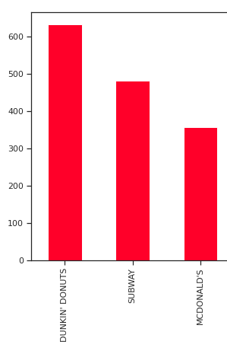
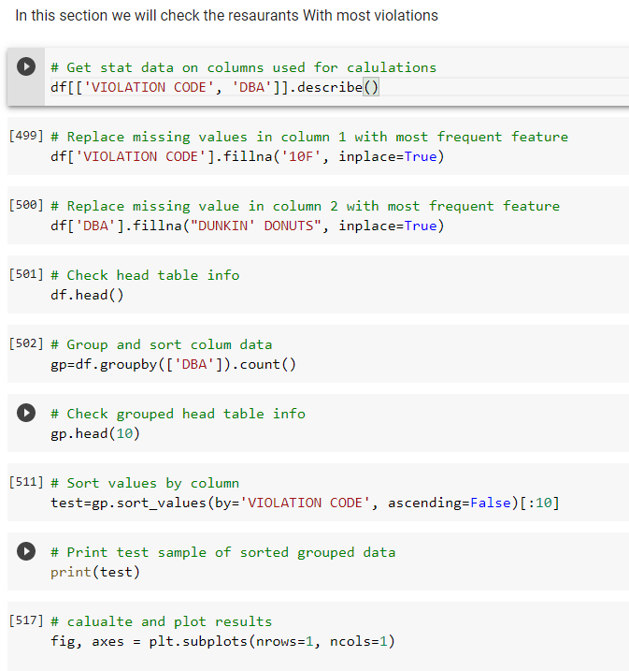
Q2 Restaurants with most Inspections
Data Results
Code Screenshot
Description These are the most frequent violations occurred at the top restaurants

Slide 10
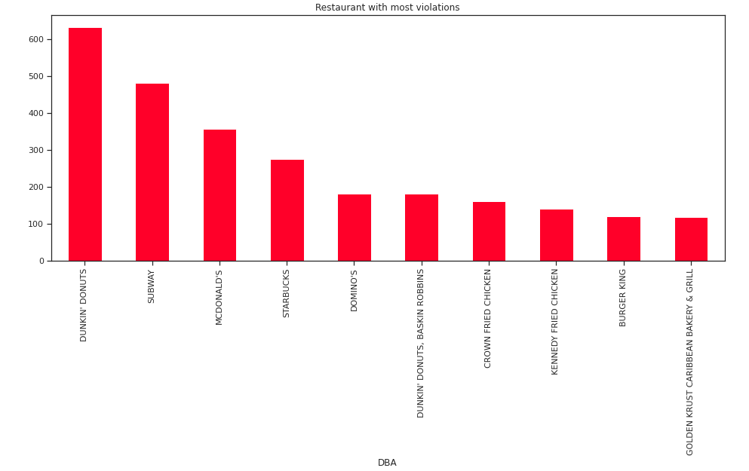
Trend Slide Top 10 restaurants with most violations

Slide 11
Conclusion Slide

Slide 12
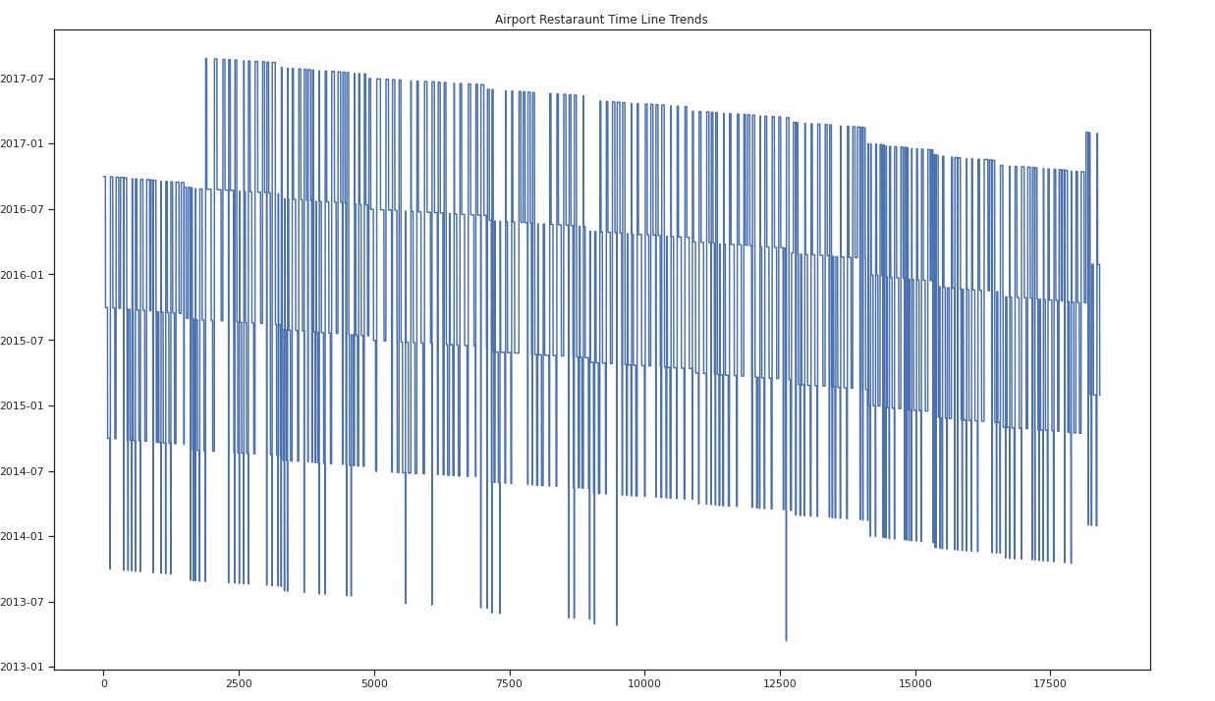
Conclusion Slide

Slide 13
Conclusion Slide
Inferences:
Over 51000 violations based on business in the data set
The most popular violation is not having correct surfaces for food to be prepared on.
Latin food received the most violations.
There are a total number of 51,000 restaurants at 41186 airports.
Dunkin Donuts being one of the most frequent restaurants at the airports.
Restaurants that received the most inspections were Dunkin Donuts, Subway, and McDonald's.
Most frequent violation date occurred in 2017 (08-12-2017) restaurants with. ( This can mean

Slide 14
Conclusion Slide
Data shows us:
There are 2078 violation between 2013 and 2017
The restaurants need to get proper surfaces to prepare food.
latin food seem to get the most recurring violations.
There are a total number of 51,000 restaurants
Bigger named business like dunkin donuts get more violations
Violations happen more during summer time)

